Slide 1
GMAN
Graph multi attention network

Slide 2
Motivation and background
Congestions and inefficient traffic flow
Some of the traffic could be redirected to avoid traffic jams

Slide 3
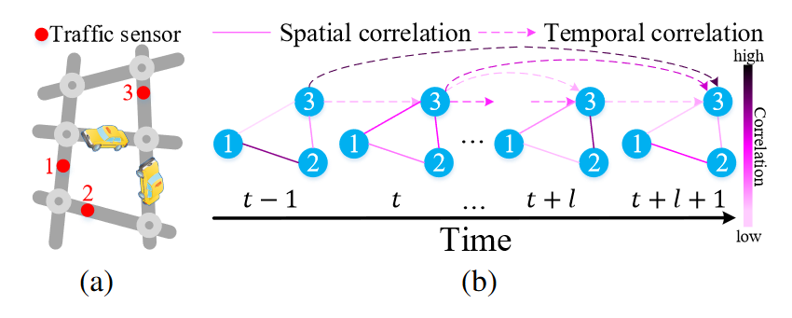
Problem description
The roadnetwork consists of intersecting roads
Each road has its own traffic sensor
There is both a spatial and temporal component for each road
Complex correlation between the spatial and temporal dimensions
Notes:
The roadnetwork consists of intersecting roads, and there is therefor an obvious spatial component

Slide 4
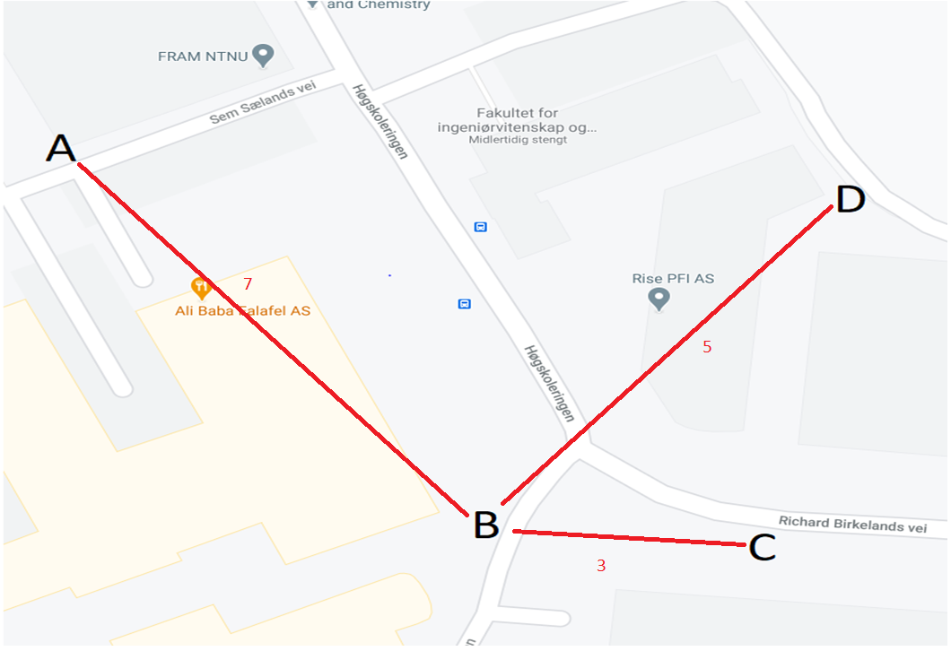
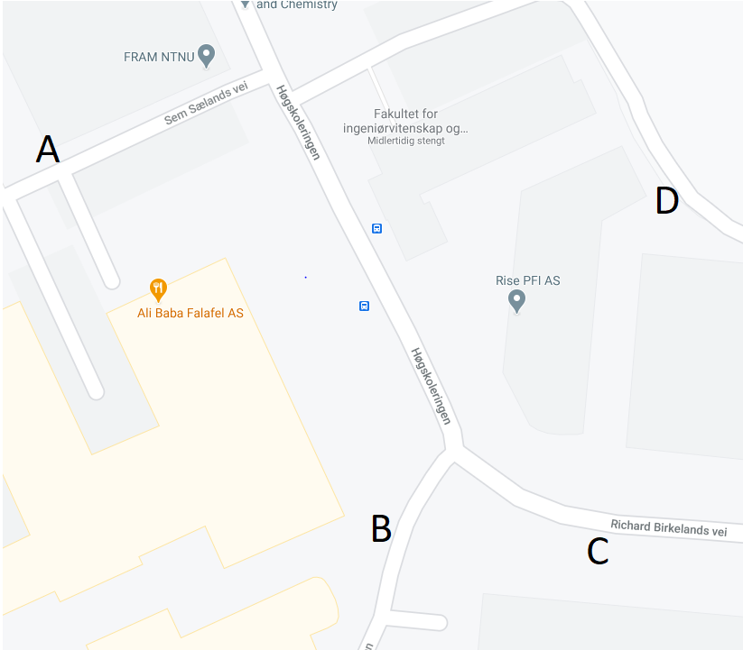
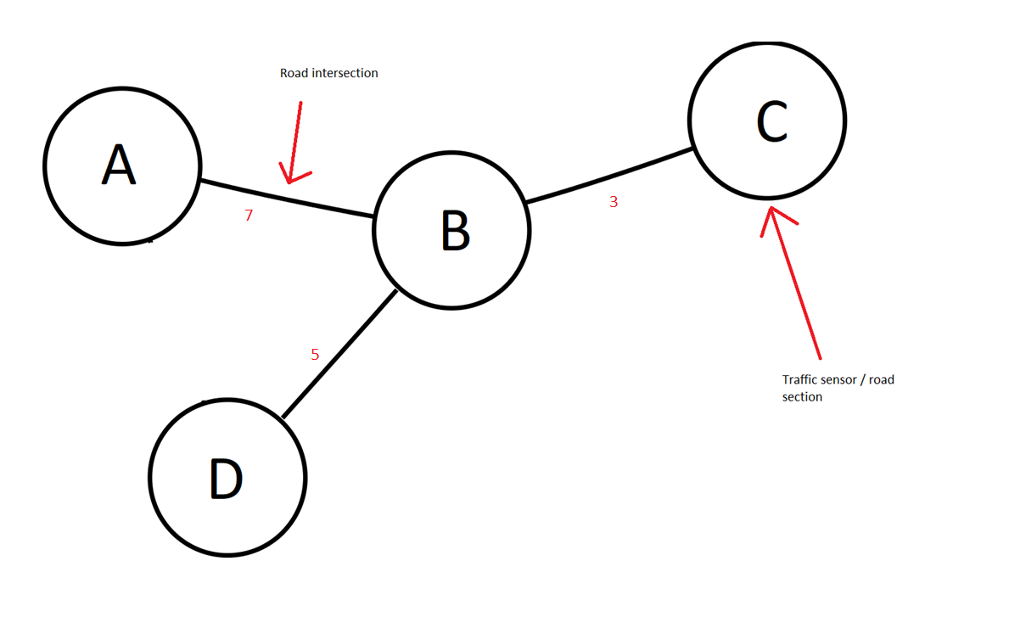
Graph representation
G=(V,E,A)
Vertices v represent both a traffic sensor and a road segment
Edges are road intersections between sensors
The weight is the distance between sensors

Slide 5
Related works
Deep learning approaches (e.g.,long short-term memory (LSTM) (Ma et al. 2015)
Auto-regressive integrated moving average (ARIMA) (Makridakis and Hibon 1997))
support vector regression (SVR) (Wu,Ho, and Lee 2004)
k-nearest neighbor (KNN) (Zheng andSu 2014)
CNN in Euclidean space (Zhang, Zheng, and Qi 2017;Yao et al. 2018; 2019)
(GCN) to model the non-Euclidean correlations in the road network (Li et al. 2018b; Lv et al. 2018).

Slide 6
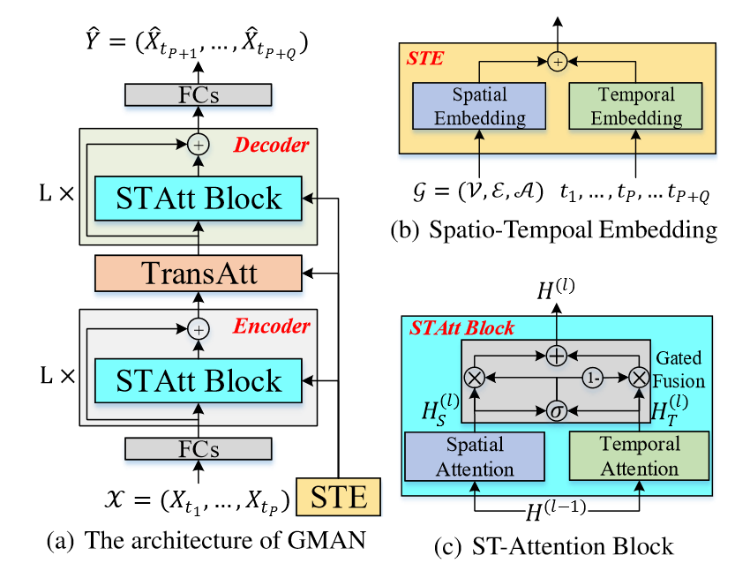
Architecture
Encoder decoder structure
Can be trained end to end by using the mean absolute error
Spatial temporal embedding STE
Spatial temporal attention block STAtt Block
Transform attention TransAtt

Slide 7
Node2vec for spatial graph input,
FCN to change dimensions to R^D
one-hot coding for weekday and hour
concencated to shape R^(7+T), FCN used to change dimensions to R^D
The vectors are simply combined by addition, resulting vector has both spatial and temporal elements

Slide 8
Each ST-Attention block is composed of spatial and temporal attention mechanisms with gated fusion
Gated fusion adjust to what extent the temporal and spatial attentions are compared to each other

Slide 9
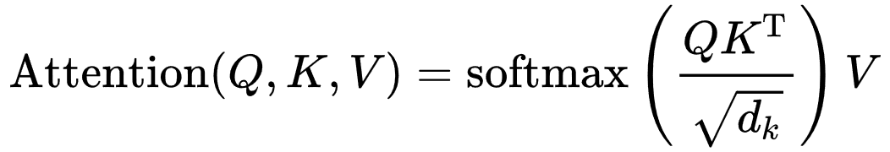
Spatial attention block
Three parallel parts query, key and value
Each uses the same FC structure consisting of; 2d convolutions , dropout, relu, batch normalization
Uses the attention formula
Then the end result is again passed trough the FC

Slide 10
Temporal attention block
Similar to spatial, only with a transposition on the key query and value
Then a mask is applied on the attention
Transposed back and FC block is applied on the output

Slide 11
Transform attention
Models the relation between timesteps to limit the error propagation
Embedding tells relevance between predicted time step and historic time step
Uses the attention score to pick relevant features across time steps

Slide 12
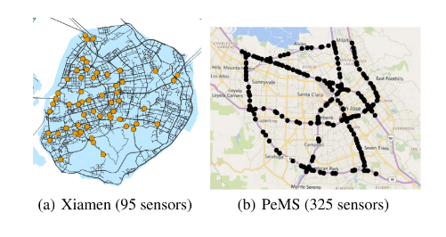
Experimental setting and results
Five minute intervals

Slide 13
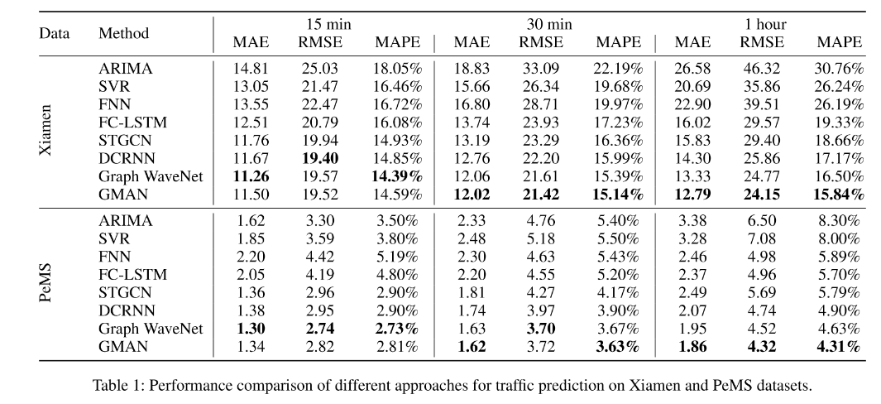

Slide 14
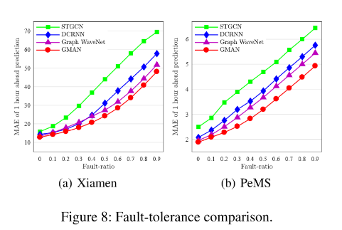
Fault comparison

Slide 15
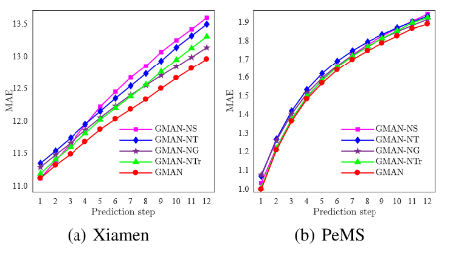
GMAN feature comparison

Slide 16
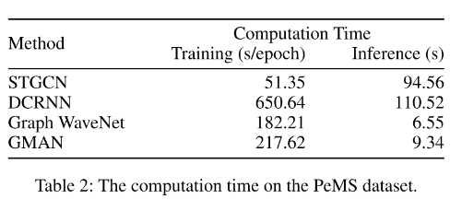
Training time

Slide 17
Conclusion
The results indicate that the GMAN works
Outperforms state of the art models in longer horizions
Next step is using GMAN in other similar problems for instance water consumpution or other time flow based problems

